Slide 1
Lecture 13
OLAP cubes and MDX

Slide 2
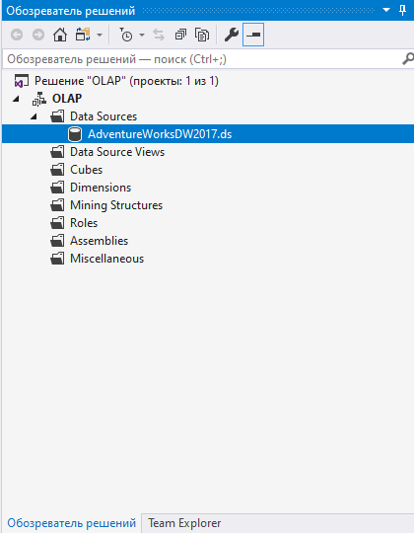
Creating olap cubes
It is necessary to use Analysis services to create OLAP cube. We use Adventure works 2017 database

Slide 3
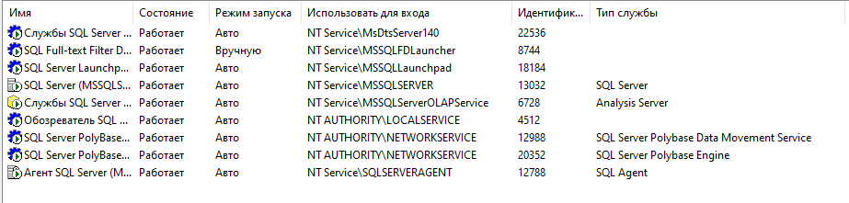
Creating olap cubes
To avoid problems connecting to the database, you need to check the connection parameters in SQL Server Analysis Services, the Log on as parameters of SQL Server and SQL Server Analysis Services

Slide 4
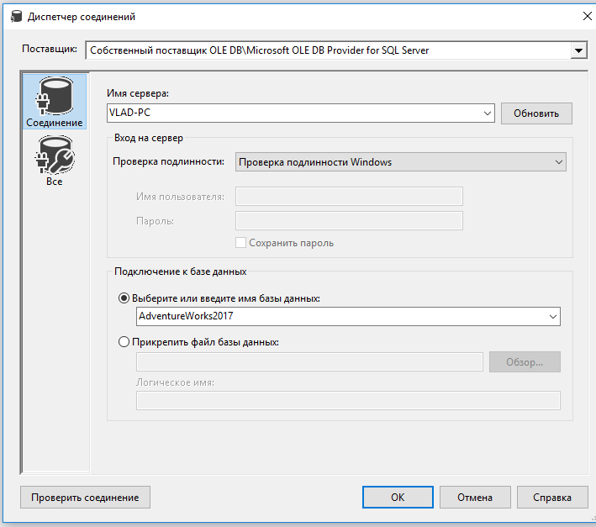
Creating olap cubes
To create an OLAP cube, you will need to create a Business Intelligence project in Microsoft Visual Studio. Install the SSDT tool and you can create this type of project in Visual Studio.

Slide 5
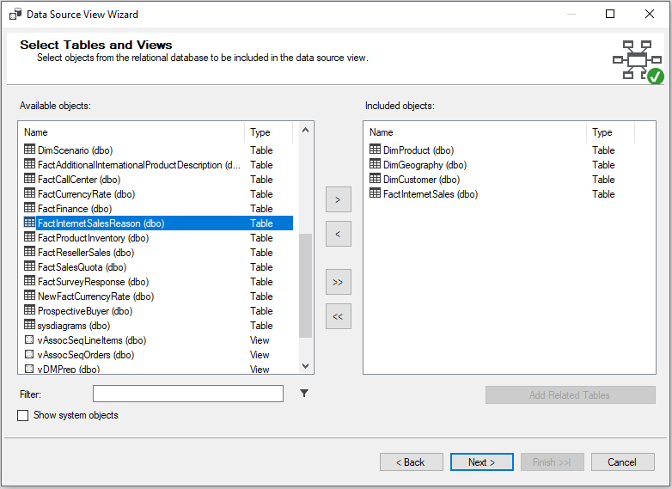
Creating OLAP cubes
In the data source view, select the desired tables from which the OLAP cube will be built.

Slide 6
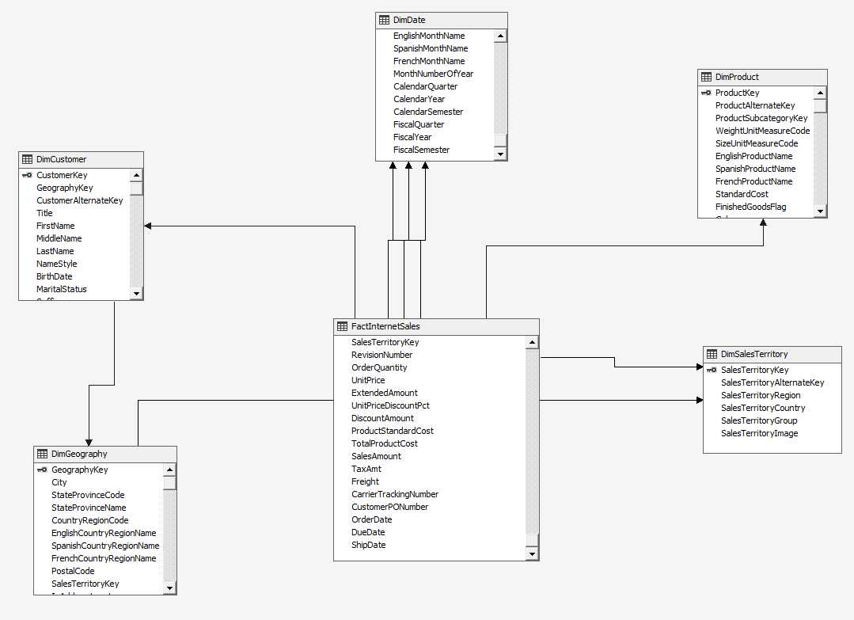
Creating OLAP cubes

Slide 7
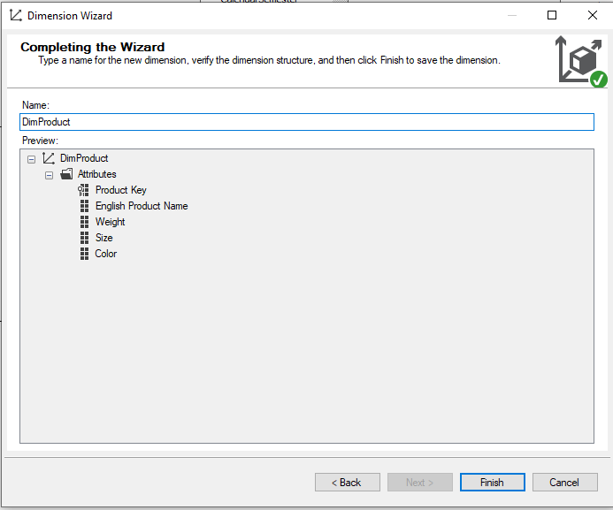
Create dimensions

Slide 8
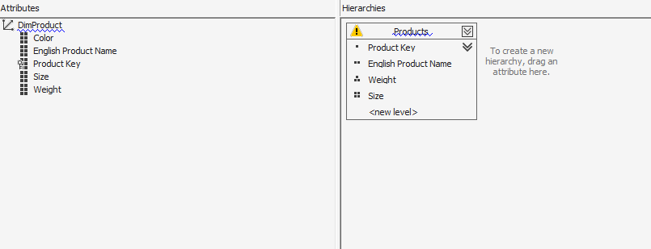
Create dimensions

Slide 9
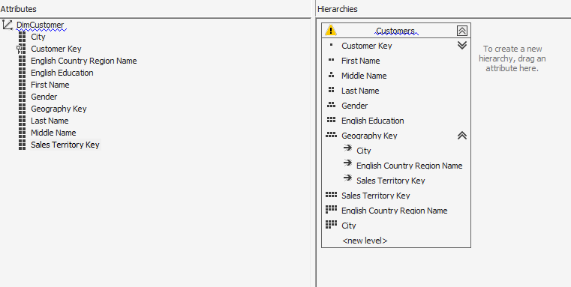
Create dimensions

Slide 10
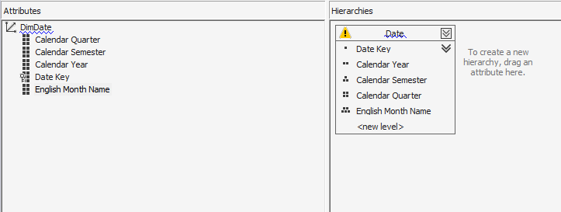
Create dimensions

Slide 11
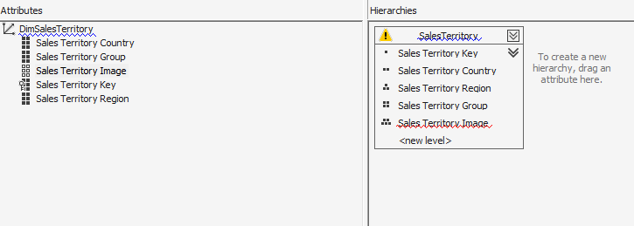
Create dimensions

Slide 12
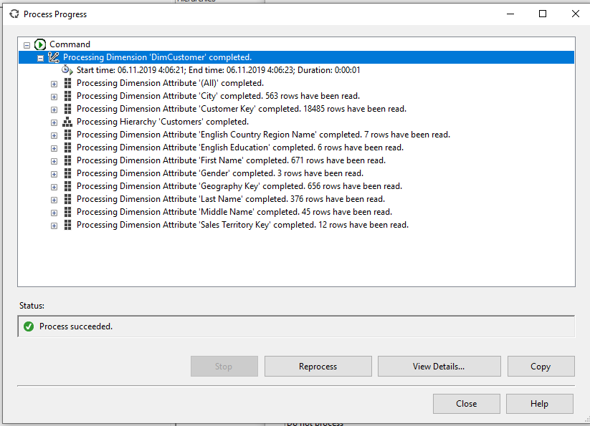
Deploy dimensions

Slide 13
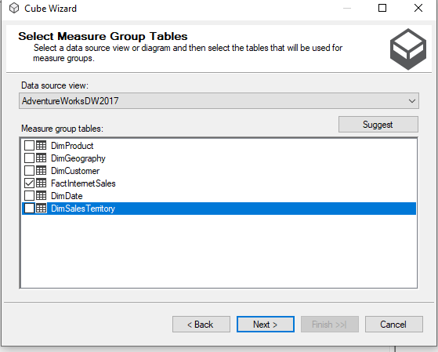
Creating the cube
After deploying dimensions, it is necessary to create the cube itself. We choose measures from one table

Slide 14
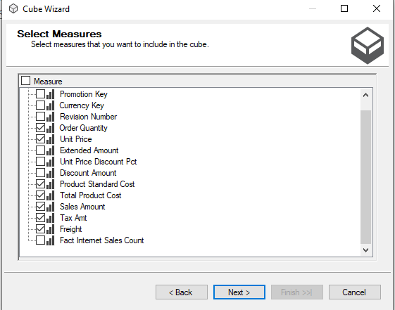
Creating the cube

Slide 15
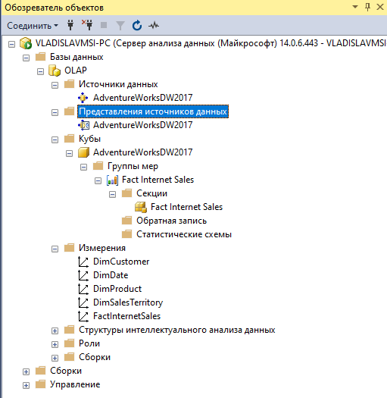
OLAP CUBE
After the deployment of the cube, connect to Microsoft SQL Analysis Services

Slide 16

MDX Dimensionality
MDX queries arrange Cube Dimensions on the Representation Dimensions ( hereafter referred as ‘Axis’ to avoid confusion )
e.g. retrieve Planned GSV measure for accounts E4098,E4398.
select
{
[Measures].[Planned GSV]
} on 0,
{
[Account].[Account Code].[E4098:47]
,[Account].[Account Code].[E4398:47]
} on 1
from [Cube REPORTING]

Slide 17
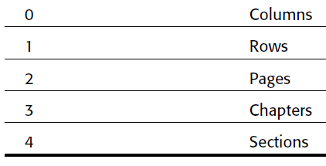
MDX Query – Axis Framework
MDX queries arrange Cube Dimensions on the Representation Dimensions ( hereafter referred as ‘Axis’ to avoid confusion )
e.g. retrieve Planned GSV measure for accounts E4098,E4398.
select
{
[Measures].[Planned GSV]
} on columns,
{
[Account].[Account Code].[E4098:47]
,[Account].[Account Code].[E4398:47]
} on rows
from [Cube REPORTING]
MDX provides names for each axis (till 4)

Slide 18

MDX query – Axis Framework
MDX queries primarily define Axis's
select
{
something
} on Axis(0),
{
Something else
} on Axis(1),
from [cube name]
select
{
[Account].[Account Code].[E4098:47]
,[Account].[Account Code].[E4398:47]
}
on Axis(0),
{
[Measures].[Planned GSV] } on Axis(1)
from [Cube REPORTING]

Slide 19
MDX query – Axis Framework
MDX queries primarily define Axis's
select
{
something
} on Axis(0),
{
Something else
} on Axis(1),
from [cube name]
Something ?
Something = set or tuple
Also note the structure of the basic MDX query

Slide 20
MDX query – tuple and SETS
Tuples
A tuple is a combination of members from one or more dimensions
-> not more than 1 member from a dimension ( same rule as co-ordinate geometry ) *
-> Many ways are there to specify a member.
( [Measures].[Planned GSV] ,[Time].[2010 HalfYear 1] )
( [Measures].[Planned GSV] ,[Time].&[64])
SETS
A Set is an ordered collection of Tuples.
select
{
[Account].[Account Code].[E4098:47]
,[Account].[Account Code].[E4398:47]
}
on Axis(0),
() – for tuples
{} – for sets
{
( [Measures].[Planned GSV] ,time.[2010 JAN])
,( [Measures].[Planned GSV] ,[Time].[2010 HalfYear 1] )
}
on Axis(0)

Slide 21
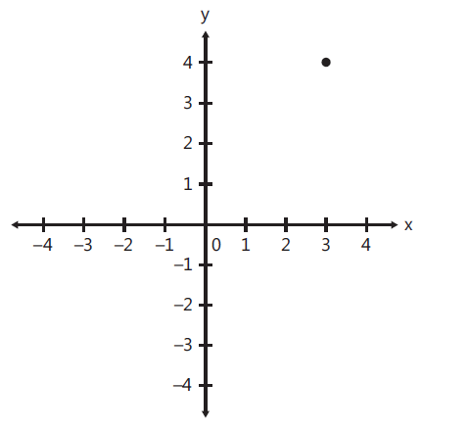
Understanding tuple
Best analogy - coordinate geometry *
2D –space
Tuple of the form (x₁,y₁ ) e.g. ( 3,4)
Tuple like (x₁,y₁ , y₂) or (x₁,x₂ , y₂) are invalid
Now apply same concept to n- dimensional cube
What are valid tuples ?
(time.year.[2011] , Product.brand.[B1])
(time.year.[2011] , Product.brand.[B1] , time.year.[2010])
(time.year.[2011] , Product.brand.[B1], Geo.[India])
(time.year.[2011] , Product.brand.[B1], Product.brand.[B2])
Understanding tuples are key to thinking in MDX .
We will stop here till all tuple related queries are clarified.
* This analogy holds good except for hierarchies. Hierarchies in cube space can be considered as dimensions in Co-ordinate geometry

Slide 22
MDX query – tuple and SETS
Something to remember
This is a set containing a single tuple
{
[Account].[Account Code].[E4098:47]
}
2. This is a single tuple
[Account].[Account Code].[E4098:47]
Both are Different things conceptually and programmatically (though SSAS overlooks it).

Slide 23
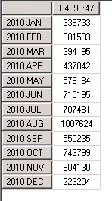
MDX query – tuple constructs
A closer look at tuple
elements separated by ‘ , ‘
Multi part identifier ‘ . ’
Can be of the form
Dimension.hierarchy.Level.member
[Time].[Time Hierarchy].[Month].&[421]
[Time].[Time Hierarchy].[Month].[2010 JAN]
Dimension.member
[Time].[2010 JAN]
Colon ‘ : ‘ used to represent a series of members
([Time].[2010 JAN]:[Time].[2010 DEC]) - all months from jan 2010 to dec 2010
select
{[Account].[E4398:47]}
on 0,
{([Time].[2010 JAN]:[Time].[2010 DEC]) }
on 1
from [Cube REPORTING]

Slide 24

MDX query – the children function
.Children
-- used to express the children of a member
e.g. as per Time hierarchy – month is the child of quarter
select { Time.[2010 Quarter 1].children }on 0,
{[Account].[E4398:47]} on 1
from [Cube REPORTING]

Slide 25
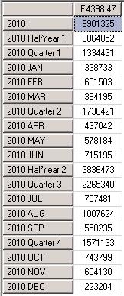
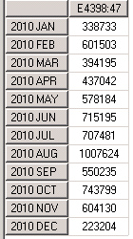
MDX query – the Descendatns function
Descendants (member [, [ level ] [, flag]] )
-- used to express the Descendant of a member at a level
Flag allows display
Select {[Account].[E4398:47]}
on 0,
{
descendants(Time.[2010],month,self)
} on 1
from [Cube REPORTING]
Select {[Account].[E4398:47]}
on 0,
{
descendants(Time.[2010],month,self_and_before)
} on 1
from [Cube REPORTING]

Slide 26
Assignment -1
Assume the following Dimensions :
Time : Year <- Quarter <- Month <- Day
Product : Dollar Sales, Unit Sales
Geo : country <- state <- city

Slide 27

Cross joins
Concept :
Two Sets - A ,B
A = {1,2,3} B = {x,y}
Cross join AxB
AxB = { (1,x), (2,x), (3,x), (1,y), (2,y), (3,y),}
Planned GSV for 2 accounts for 3 months --
select
{
(account.[Account Code].[E4098:47]),
(account.[Account Code].[E4400:47])
}
* -- cross join
{
time.[2010 JAN] : time.[2010 MAR]
}
on 0,
{
[Measures].[Planned GSV]
}on 1
from
[Cube REPORTING]

Slide 28
Filter
Concept :
Filter ( Set , Expression )
Accounts which have more than GSV
select
filter
(
(account.[Account Code].members),
[Measures].[Planned GSV] > 10000000
)
on 0,
{
[Measures].[Planned GSV]
}on 1
from
[Cube REPORTING]
.members gives all members of that level

Slide 29
Filter
What is the meaning of this ?
elect
filter
(
(account.[Account Code].members),
([Measures].[Planned GSV] ) > 10000000
)* -- cross join
{
time.[2010 JAN] : time.[2010 MAR]
}
on 0,
{
[Measures].[Planned GSV]
}on 1
from
[Cube REPORTING]

Slide 30

Filter
And this ?
select
filter
(
(account.[Account Code].members),
([Measures].[Planned GSV] ,time.[2010 JAN]) > 10000000
)* -- cross join
{
time.[2010 JAN] : time.[2010 MAR]
}
on 0,
{
[Measures].[Planned GSV]
}on 1
from
[Cube REPORTING]
Tuple reference is one of the powerful concepts in MDX

Slide 31
order
Concept :
Order (set1, expression [, ASC | DESC | BASC | BDESC])
Accounts ordered by GSV
select
non empty (
order
(
(account.[Account Code].members),
([Measures].[Planned GSV] )
)
)
on 0,
{
[Measures].[Planned GSV]
}on 1
from
[Cube REPORTING]

Slide 32
Accounts ordered by ???
select
non empty (
order
(
(account.[Account Code].members),
([Measures].[Planned GSV],time.[2011 JAN] )
)
)
on 0,
{
[Measures].[Planned GSV]
}on 1
from
[Cube REPORTING]

Slide 33



Tuple instead of expression used
The Where Clause
select
from
[Cube REPORTING]
where
([Measures].[Planned GSV] )
select
from
[Cube REPORTING]
where
([Measures].[Planned GSV],time.[2010 JAN] )
select
from
[Cube REPORTING]
where
([Measures].[Planned GSV],time.[2010 JAN] ,account.[Account Code].[E4400:47] )

Slide 34

Named Sets : Ease of reference
with set [great accounts] as
{
[Account].[Account Code].[E1373:47],
[Account].[Account Code].[E40301:47]
}
select
{
[Measures].[Planned GSV]
}
on 0,
non empty
{
[great accounts]
} on 1
from [Cube REPORTING]
Also possible to create persistent named Sets
create set [Cube REPORTING].[test accounts] as
{
[Account].[Account Code].[E1373:47],
[Account].[Account Code].[E40301:47]
}

Slide 35
Calculated members : the power of MDX !!!!
1. Simple Calculated members
Find the Average sales price ( i.e. Total Dollar sales / number of units sold ) for the quarters
2005 Q1 and Q2.
WITH
MEMBER [Measures].[Avg Sales Price] AS
[Measures].[Dollar Sales] / [Measures].[Unit Sales]
SELECT
{ [Measures].[Dollar Sales]
[Measures].[Unit Sales]
, [Measures].[Avg Sales Price] }
on columns,
{ [Time].[Q1, 2005]
, [Time].[Q2, 2005]
}
on rows
FROM Sales
Simple Division used to calculate a new measure
 | Dollar Sales | Unit Sales | Average Sales price
Q1, 2005 | 100 | 5 | 20
Q2, 2005 | 120 | 8 | 15

Slide 36
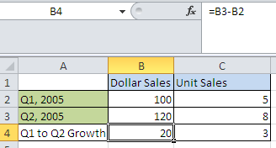
Calculated members : the power of MDX !!!!
2. Calculated members of medium complexity
Find the Quarter on quarter growth for Dollar sales and unit sales for the quarters
2005 Q2.
Growth in dollar sales = 2005 Q2 Dollar sales - 2005 Q1 Dollar sales
Growth in unit sales = 2005 Q2 unit sales - 2005 Q1 unit sales
WITH
MEMBER [Time].[Q1 to Q2 Growth] AS
[Time].[Q2, 2005] - [Time].[Q1, 2005]
SELECT
{ [Measures].[Dollar Sales]
, [Measures].[Unit Sales] }
on columns,
{ [Time].[Q1, 2005]
, [Time].[Q2, 2005]
, [Time].[Q1 to Q2 Growth] }
on rows
FROM Sales
WHERE ([Customer].[MA])
How does this take care of both subtractions ?

Slide 37
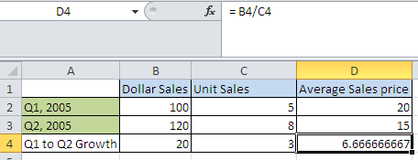
Calculated members : the power of MDX !!!!
Precedence resolutions
Combining previous two problems , write MDX to calculate Q1 to Q2 growth in average Sales prices
WITH
MEMBER [Measures].[Avg Sales Price] AS
[Measures].[Dollar Sales] / [Measures].[Unit Sales]
MEMBER [Time].[Q1 to Q2 Growth] AS
[Time].[Q2, 2005] - [Time].[Q1, 2005]
SELECT
{ [Measures].[Dollar Sales], [Measures].[Unit Sales],
[Measures].[Avg Sales Price]
}
on columns,
{ [Time].[Q1, 2005], [Time].[Q2, 2005], [Time].[Q1 to Q2 Growth] }
on rows
FROM [Sales]

Slide 38
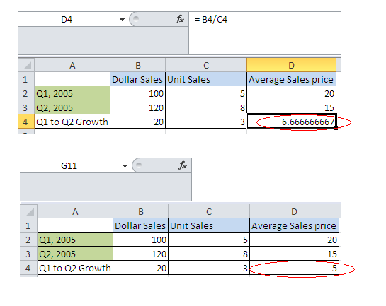
Calculated members : the power of MDX !!!!
Precedence resolutions
Combining previous two problems , write MDX to calculate Q1 to Q2 growth in average Sales prices
WITH
MEMBER [Measures].[Avg Sales Price] AS
[Measures].[Dollar Sales] / [Measures].[Unit Sales],
SOLVE_ORDER = 0
MEMBER [Time].[Q1 to Q2 Growth] AS
[Time].[Q2, 2005] - [Time].[Q1, 2005],
SOLVE_ORDER = 1
SELECT
{ [Measures].[Dollar Sales], [Measures].[Unit Sales],
[Measures].[Avg Sales Price]
}
on columns,
{ [Time].[Q1, 2005], [Time].[Q2, 2005], [Time].[Q1 to Q2 Growth] }
on rows
FROM [Sales]

Slide 39
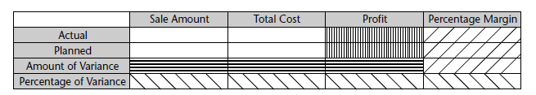
Calculated members : the power of MDX !!!!
Write an MDX to get the following result
Measures -> Measures.[Sales Amount], Measures.[Total Cost]
Dimensions -> Phase.Actual , Phase.Planned
Use normal formulas for profit , percentage margin , amount of variance, percentage of variance.

